Slide 1

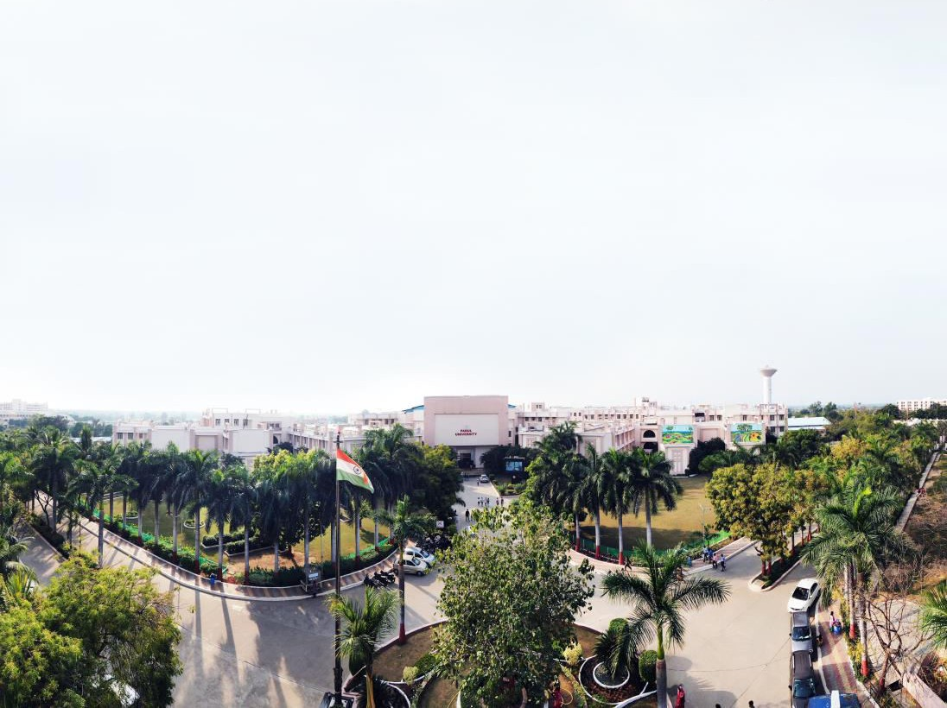




Design and analysis of Algorithms
Anand Jawdekar
Assistant Professor CSE Department

Slide 2
Unit-4
Dynamic Programming

Slide 3
Chain matrix multiplication
Matrix Chain Multiplication is a classic problem in computer science and dynamic programming. The problem is to determine the most efficient way to multiply a given sequence of matrices. The goal is to minimize the number of scalar multiplications.

Slide 4
Problem Statement
Given a sequence of matrices A1,A2,…,An , where matrix Ai​ has dimensions pi−1×pi, the task is to determine the optimal parenthesization of the product A1,A2,…An.​ that minimizes the number of scalar multiplications.

Slide 5
Why is this Problem Important?
Matrix multiplication is associative, meaning that the order in which we multiply the matrices does not change the result, but the computational cost (number of scalar multiplications) can vary greatly depending on how the matrices are parenthesized..
For three matrices A, B and C, where A is 10×100, B is 100×5 and C is 5×50
If we first multiply A and B, the cost is 10×100×5=5000 operations, then multiplying the result with C costs 10×5×50=2500 operations, for a total of 7500 operations.
If we first multiply B and C, the cost is 100×5×50=25000 operations, then multiplying the result with A costs 10×100×50=50000 operations, for a total of 75000 operations.

Slide 6
Dynamic Programming Approach
To solve this problem efficiently, we use dynamic programming. We define the following:
Let m[i,j] represent the minimum number of scalar multiplications needed to compute the matrix ,AiAi+1…Aj​.
The goal is to compute m[1,n].
The recursive formula is:
m[i,j]=min⁡_{i≤k<j}{m[i,k]+m[k+1,j]+p_{i−1}×pk×pj}

Slide 7
Steps:
Initialize the matrix m where m[i,i]=0 for all i.
Compute m[i,j] for all i and j using the above recursive formula, filling in the values from smaller subproblems to larger ones.
Return m[1,n] as the result.

Slide 8
Example
Suppose you have four matrices 𝐴1(10×30), 𝐴2(30×5), 𝐴3(5×60),and
𝐴4(60×10).Compute the cost for multiplying subproblems:𝑚[1,2] computes multiplication cost for 𝐴1×𝐴2​ 𝑚[2,3] for 𝐴2×𝐴3​ , and so on. Use the recursive formula to compute 𝑚[1,𝑛].
Return the minimum cost and the optimal parenthesization.

Slide 9
Time Complexity
The time complexity of this dynamic programming algorithm is O(n³), and it requires O(n²) space to store the table of results.
Matrix Chain Multiplication is a useful algorithm in optimization problems, particularly in compiler design, computer graphics, and operations research.
.

Slide 10
Step by Step Solution
Step-by-Step Solution
Matrix Dimensions: We have the dimensions array p=[10,30,5,60,10]
Initialize the m Table: We create an n×n table (where nis the number of matrices). The table will be used to store the minimum number of scalar multiplications needed for matrix chain multiplication.
Here, n=4 (since there are 4 matrices). The table m[i][j]m[i][j]m[i][j] will store the minimum multiplication cost for multiplying matrices Ai​ through Aj​.
Initially, m[i][i]=0 for all iii (since multiplying a single matrix has no cost).
Fill the Table: We need to fill in the table mmm by considering different chain lengths, from 2 matrices up to all 4 matrices. We apply the recursive formula:
m[i,j]=min⁡_{i≤k<j}{m[i,k]+m[k+1,j]+p_{i−1}×pk×pj}

Slide 11
Step by Step Solution
Chain Length 2:
For m[1,2]=10×30×5=1500
For m[2,3]=30×5×60=9000
For m[3,4]=5×60×10=3000
Chain Length 3:
For m[1,3]:
k=1: m[1,1]+m[2,3]+10×30×60=0+9000+18000=27000
k=2: m[1,2]+m[3,3]+10×5×60=1500+0+3000=4500
Minimum: m[1,3]=4500
For m[2,4]:
k=2: m[2,2]+m[3,4]+30×5×10=0+3000+1500=4500
k=3: m[2,3]+m[4,4]+30×60×10=9000+0+18000=27000
Minimum: m[2,4]=4500
Chain Length 4:
For m[1,4]:
k=1: m[1,1]+m[2,4]+10×30×10=0+4500+3000=7500
k=2: m[1,2]+m[3,4]+10×5×10=1500+3000+500=5000
k=3k: m[1,3]+m[4,4]+10×60×10=4500+0+6000=10500

Slide 12
Step by Step Solution
Minimum: m[1,4]=5000
Result: The minimum number of scalar multiplications needed to multiply matrices A1A2A3A4​ is 5000.
Parenthesization
To determine the optimal parenthesization:
The optimal split for m[1,4] was at k=2.
Therefore, the optimal parenthesization is (A1(A2A3))A4​.
This means you first multiply A2​ and A3​, then multiply the result with A1​, and finally multiply that result with A4.
This method efficiently minimizes the total number of scalar multiplications, saving computational resources in practical applications.

Slide 13
Longest Common Subsequence
The Longest Common Subsequence (LCS) problem is a classic problem in computer science, especially in fields like bioinformatics, version control, and text comparison. The problem is to find the longest subsequence common to two sequences, where a subsequence is a sequence derived by deleting some or none of the elements from the original sequence without changing the order of the remaining elements.

Slide 14
Problem Statement
Given two sequences X and Y, the objective is to find the length of the longest subsequence that is common to both sequences.
Example
Consider the two sequences:
X="ABCBDAB"
Y="BDCAB"
The LCS for these two sequences is "BCAB", which has a length of 4.

Slide 15
Dynamic Programming Approach
The LCS problem can be efficiently solved using dynamic programming. The idea is to build a 2D table that stores the lengths of the longest common subsequences for substrings of X and Y.
Steps:
Define the DP Table:
Let mmm be the length of sequence X and n be the length of sequence Y.
Define a 2D array L where L[i][j] represents the length of the LCS of the sequences X[0…i-1]and Y[0...j-1].
Recurrence Relation:
If X[i−1]=Y[j−1], then L[i][j]=L[i−1][j−1]+1.
Otherwise, L[i][j]=max⁡(L[i−1][j],L[i][j−1]).
Initialize the Table:
Initialize L[0][j]=0 for all j, and L[i][0]=0 for all i. This is because the LCS of any sequence with an empty sequence is 0.
Fill the Table:
Iterate through each character of XXX and YYY to fill in the table based on the recurrence relation.
Result:
The length of the LCS will be found in L[m][n].

Slide 16
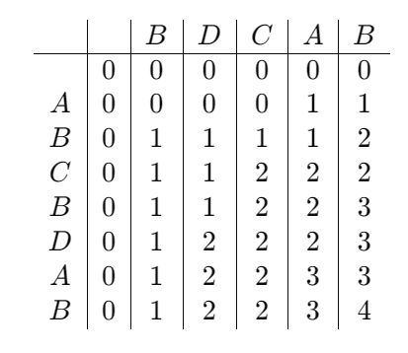
Example Solution
Let's solve the LCS problem for X="ABCBDAB"X = "ABCBDAB"X="ABCBDAB" and Y="BDCAB"Y = "BDCAB"Y="BDCAB".
Initialization:
Let m=7 (length of "ABCBDAB") and n=5 (length of "BDCAB").
Initialize the table L with dimensions 8×6 (since we add an extra row and column for the base case where either sequence is empty).
Fill the Table:
Result:
The length of the LCS is L[7][5]=4L[7][5] = 4L[7][5]=4.

Slide 17
Time and Space Complexity
Time Complexity: O(m×n), where m and n are the lengths of the sequences X and Y.
Space Complexity: O(m×n), though it can be optimized to O(min⁡(m,n)) by using only two rows of the table at a time.

